Slide 1

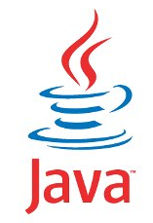
JAVA SE
(Core java)
Lecture 1
Mr. Sachin Kapoor
(CEO)
+919826086245

Slide 2

Today’s Agenda
An Introduction to JAVA
Necessity Of Programming
What Is Java ?
Important Features
History Of Java
Where Java stands today ?
Java Ecosystem

Slide 3
Why Do We Need Programming ?
To communicate with digital machines and make them work accordingly
Today in the programming world , we have more than 750 languages available.
And every language is designed to fulfill a particular kind of requirement

Slide 4
Brief History Of Prog. Lang
C language was primarily designed to develop “System Softwares” like Operating Systems, Device Drivers etc .
To remove security problems with “C” language , C++ language was designed.
It is an Object Oriented Language which provides data security and can be used to solve real world problems.
Many popular softwares like Adobe Acrobat , Winamp Media Player,Internet Explorer,Mozilla Firefox etc were designed in C++
Courtsey:http://www.stroustrup.com/applications.html

Slide 5
What is JAVA???...
JAVA is a Technology(not only a programming language) to develop Object oriented and Platform Independent applications.
Platform Independence
Technology

Slide 6
Platform Independence
PLATFORM
A Platform is an environment in which a program runs.
In simple terms it is combination of Operating system and Processor.
Example:- Windows+Intel(i5), Ubuntu+AMD
Operating System
Platform
Processor

Slide 7
How many physical machines are there in the figure ?
Answer:
12 Physical Machines
Windows (32 bit)
Mac
Linux
Windows(32 bit)
Windows (64 bit)
Linux
Mac
Linux
Windows (64 bit)
Linux
Windows(32 bit)
Mac

Slide 8
How many platforms are there in the figure ?
Answer:
Only 4
Windows (32 bit)
Mac
Linux
Windows(32 bit)
Windows (64 bit)
Linux
Mac
Linux
Windows (64 bit)
Linux
Windows(32 bit)
Mac

Slide 9
What makes it platform Independent?
Program Execution in C/C++
Source Code
Compiler
Machine Code
Windows
Linux

Slide 10
Program Execution in JAVA
Source Code
Compiler
Byte Code
JVM
JVM
JVM
MacOS
Windows
Ubuntu

Slide 11
QUIZ 3
What does JVM(Java Virtual Machine) do?
Compiles the Java Source Code
Generates bytecode
Converts bytecode to underlying machine’s instruction set.
Checks for error

Slide 12
QUIZ 4
Java Compiler for every platform is different
True
False

Slide 13
QUIZ 5
The JVM for every platform is different
True
False

Slide 14
Important Features
Platform Independent
Automatic Memory Management
Secure
Robust
Simple
Multithreaded
Distributed

Slide 15
Important Features
Platform Independent
A platform is the environment in which an application
runs.
In other words it is the combination of an OS and a CPU.
For example:
Windows 8+Intel - Core i5 (is a diff. platform)
Linux + AMD -A6(is another diff platform)
Mac + Intel -Core i3(is yet another diff platform)

Slide 16
Important Features
Now being platform independent means that an application developed and compiled over one platform can be executed over any other platform without any change in the code.
And , Java has this capability using the concept of “bytecode” and “JVM”

Slide 17
Important Features
Whenever we compile a java program , the compiler never generates machine code.
Rather it gnerates a machine independent code called the “bytecode”.
This bytecode is not directly understandable by the platform(OS & CPU).
So another special layer of software is required to convert these bytecode instructions to machine dependent form

Slide 18
Important Features
This special layer is the JVM , that converts the bytecode to underlying machine instruction set and runs it.

Slide 19
Important Features
class HelloWorld {
public static void main(String args[ ]) {
System.out.println(“Hello World!”);
}
}
Java Program
Compiler
Interpreter
Interpreter
Interpreter
Hello World!
Hello World!
Hello World!
Win32
Solaris
MacOS
Notes:
Java is Portable
In the past, portability was not as much of a concern as it has become today. Most applications were fairly static in the sense that they were deployed on a consistent platform and did not require a lot of changes and tinkering to keep them running. However, in modern systems it is not at all uncommon for many components to be distributed across various hardware, operating systems, and networks. This heterogeneousness would pose great problems for many languages, but not Java!
Java applications can run practically anywhere. This makes Java quite revolutionary. Essentially anything that has some kind of processor can be Java-enabled, from mainframes to personal computers to telephones and beyond. Java programs are flexible enough to be local applications, web-based applets, server-side applications, and embedded software. The application code does not usually have to be changed to run on these different devices either. This means you can truly write the code once and run it anywhere you wish.
The key to this portability is the interpreted nature of the language. Since code does not have to be compiled to specific platforms, your Java program can be anywhere a JVM exists. The world does not run on one type of platform alone and new platforms are constantly being introduced. By being portable, java programs written today can still be viable tomorrow.

Slide 20
Important Features
Thus any such platform for which a JVM is available can be used to execute a Java application irrespective of where it has been compiled.
This is how java makes itself “Platform Independent” and it also truly justifies java’s slogan of “WORA”(Write Once Run Anywhere)

Slide 21
Important Features
Automatic Memory Management
In languages like C and C++ any dynamic memory which the programmer allocates using malloc( ) or new has to be deallocated by himself using free( ) or delete
But Java uses runtime automatic garbage collection
feature where the JVM itself deallocates any dynamic
memory which our program allocated.

Slide 22
Important Features
Secure
Java does not use pointers explicitly.
Moreover all the programs in java are run under an area known as the sand box.
This sandbox uses a bytecode verification process to
ensure that code loaded does not violate Java security
constraints.

Slide 23
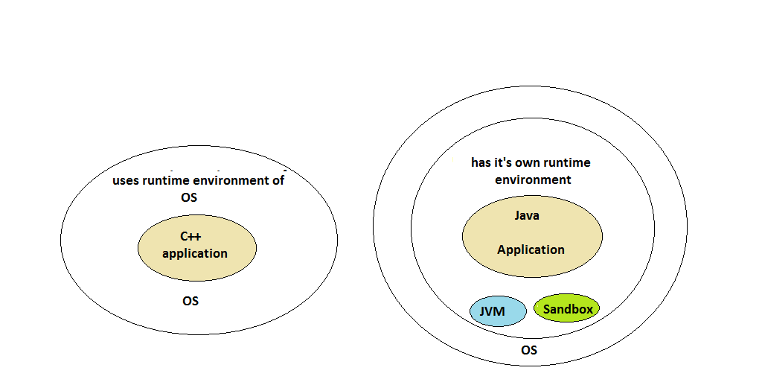
Important Features

Slide 24
Important Features
Robust
Java has very strict rules which every program must
compulsorily follow and if these rules are
violated then JVM kills/terminates the code by
generating “Exception”

Slide 25
Important Features
To understand java’s robustness , guess the output of the following C/C++ code:
int arr[5];
int i;
for(i=0;i<=9;i++)
{
arr[i]=i+1;
}
// Unpredictable, after i is 5

Slide 26
Important Features
The previous code might show uncertain behaviour in C/C++ i.e. if memory is available after arr[4] , then the code will run , otherwise it will generate error at runtime.
On the other hand if in java this code is executed, the JVM will kill the application as soon as it finds the statement arr[5]=. . .
Reason is that in java we are not allowed to access any array beyond it’s upper/lower index

Slide 27
Important Features
Simple
Java borrows most of it’s syntax from C/C++ languages.
Moreover it has inherited best points from these
languages and dropped others.
Like it has removed pointers, multiple inheritance etc as
developers of java language found these features to
be security threat and confusing.
Thus if we have basic understanding
of C/C++ languages it is very easy to learn Java

Slide 28
Important Features
Object Oriented
Java supports all important concepts of OOPs, like
Encapsulation
Inheritance
Polymorphism
Abstraction

Slide 29
Important Features
Multithreaded
Multithreading means concurrent execution.
In simple terms it means that we can execute more than one
part of the same program parallelly/simultaneously.

Slide 30
QUIZ 6
Can we say that if we are surfing the internet using our browser and at the same time we are listening to song in winamp, the it is multithreading ?
True
False
It is mutlitasking not multithreading

Slide 31
Important Features
To understand this feature consider the code given below:
main()
{
clrscr();
factorial(5);
prime(8);
evenodd(4);
}
.
.
.

Slide 32
Important Features
In the previous sample code all 4 functions clrscr(),factorial(),prime() and evenodd() are independent of each other but still they will run sequentially i.e. one after the other.
This can be improved in java by using multithreading feature so that each one of these functions can run together.
Benefits: Reduced execution time , full utilization of CPU

Slide 33
Important Features
Some practical examples where multithreading is used are:
We can open multiple tabs in the same browser window
When we use a media player to listen to a song , then there are multiple activities which take place parallely like moving of a slider, elapsed time being shown, volume adjustment , ability to add or remove songs from the playlist , playing of the song etc

Slide 34
Important Features
Distributed
Distributed programming a program uses more than
one computer.
That is, different parts of the same program run on
different computers and communicate over a network.

Slide 35
Important Features
In Java, this is made possible by a technique called RMI(Remote Method Invocation)
RMI allows a method that is running on one computer to call a method in an object that is on another computer.
Benefits: Programmers working on same project may be required to be physically present at the same location

Slide 36
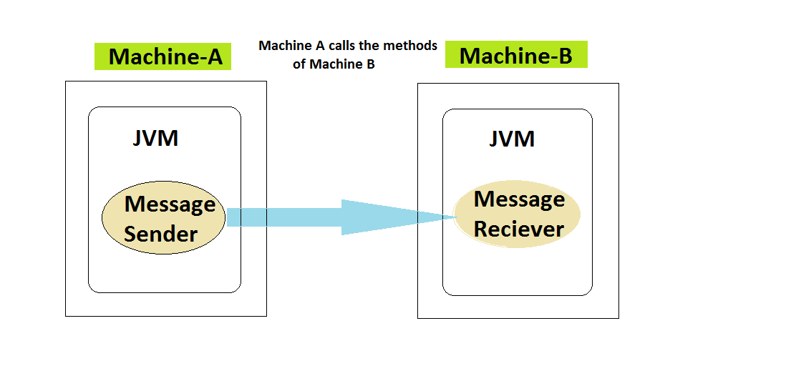
Important Features
Benefits: Programmers working on same project may be required to be physically present at the same location

Slide 37

History
Developed By: James Gosling
Company Name: Sun Microsystems,
now known as Oracle Sun.
Original Name: Oak.
First release: 23rd January 1996 and called
JDK(Java Development kit) 1.0
Latest version : JDK(8.0) released on 18th March 2014.
James Gosling

Slide 38
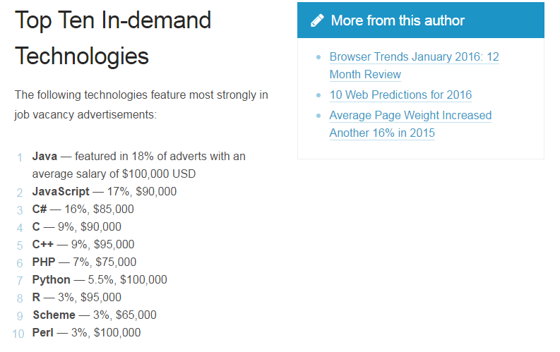
Where Java Stands Today ?
http://www.sitepoint.com/best-programming-language-learn-2015-job-demand-salaries/

Slide 39
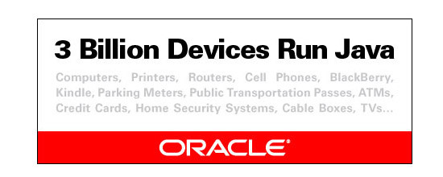
Where Java Stands Today ?
Do you know how many devices use Java ?
3 Billion devices run Java as per Oracle. (1 Billion= 100Crores)
1 Billion Java downloads per year.

Slide 40



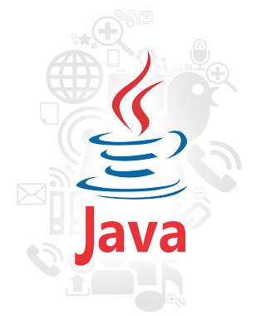
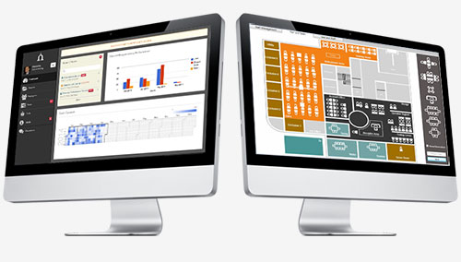


JAVA Ecosystem

Slide 41

End Of Lecture 1
For any queries mail us @: scalive4u@gmail.com
Call us @ : 0755-4271659, 7879165533
Agenda for Second Lecture:
Editions Of Java
Difference between JDK,JRE and JVM
Downloading & Installing Java
Developing First Java Program

